Slide 1

SMART TRAFFIC MANAGEMENT
EDGE CLOUD IOT BASED
TEAM - 29 REVIEW 2
TITLE: INTERNET OF THINGS
CHALLENGE: TASK SCHEDULING

Slide 2
UPDATES FROM REVIEW-1
IMPLEMENTATION STRATEGY :
DATA SOURCE: Raw data collected from SUMO Simulator which generates traffic .
Output : Vehicle Details such as vehicle speed, distance, GPS coordinates.
The vehicle's details exported to CSV File
Fuzzy Module: Provides a base green time for each traffic signal using membership functions and fuzzy rules based on vehicle speed and queue length, converting uncertain traffic conditions into a crisp initial green time.
Q-Learning Module: Dynamically adjusts the fuzzy base green time using reinforcement learning, learning optimal green durations over time to minimize congestion and improve traffic flow.

Slide 3
OUTPUT FORMAT FROM TRAINED ML MODEL: CSV/TensorFlow Lite (.tflite) WITH
intersection_id
time_bin
vehicle_count
avg_speed
congestion_score
current_green,fuzzy_delta
suggested_green_fuzzy
This output file will be added to the raw data collection code.
Then the file will be placed as an edge node for the preprocessing of the raw data.
Preprocessing will be done in the edge than sending the all the raw data to the cloud
Sending the results of edge node to cloud for decision making.

Slide 4
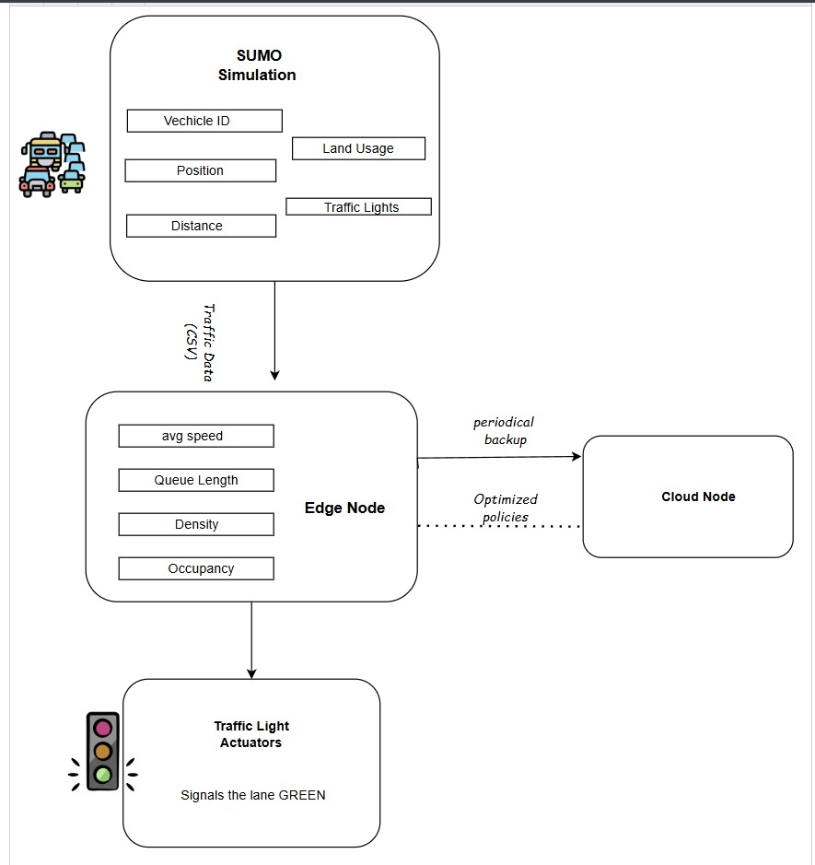
Architectural Design

Slide 5
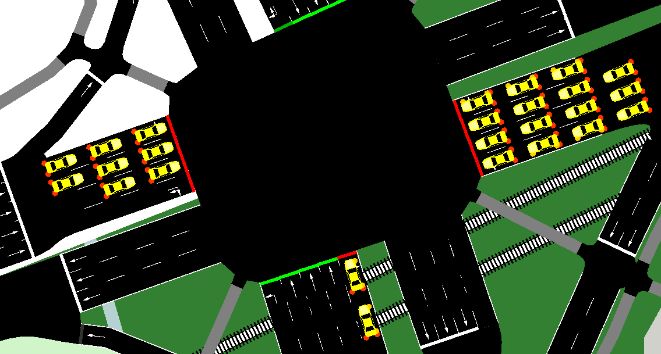
Traffic Simulation with Adaptive TLC
Objective: Simulate traffic at junction using SUMO to collect vehicle data and optimize traffic light timing.
Methodology:
Tool: SUMO with TraCI
Data collected: Vehicle position, GPS coordinates, speed, lane, distance, traffic light states.
Adaptive Control: Adjusts the traffic light phase duaration based on lane metrics
Key functions which we have used in our code:
get_lane_metrics: Calucate queue, density,occupancy and speed.

Slide 6
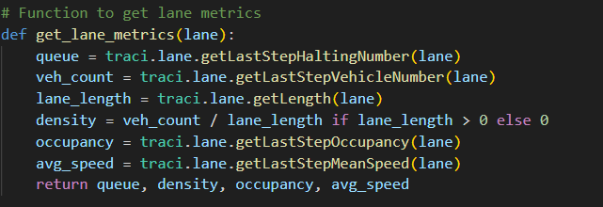
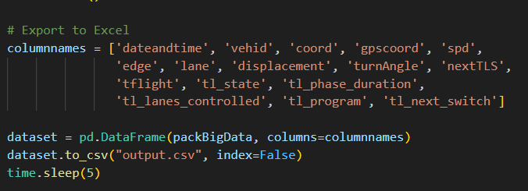
Code Snippets of Collecting Raw Data and Storing it in a CSV File

Slide 7
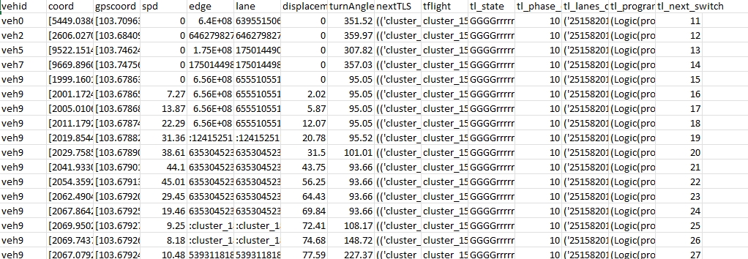
Results Of Raw Data Collection
Output: Data exported to csv file with vehicle details (speed, position, etc..) and traffic light states(phase duration, state, controlled lanes). This csv file we will giving to CI Team to train the ML model.
Key metrics:
Vehicle data: Speed, distance, lane usage and upcoming traffic lights
Traffic Light: Adaptive phase durations based on the congestion level and queue length

Slide 8
FUZZY MODULE
Objective
Provides base estimation of green light duration based on traffic conditions.
Inputs & Membership values
Inputs: Queue length and average traffic speed.
Fuzzification: Uses membership functions to define traffic states: low, medium, high speed; short, medium, long queue
Decision Process
Apply IF–THEN rules to decide adjustment:
IF queue is long AND speed is low → extend green light.
IF queue is short AND speed is high → shorten green light.
Performs defuzzification to convert fuzzy output into crisp green time
Output :
Base green time per edge/lane.
Integration with Q-learning
Base green time from fuzzy logic is input for Q-Learning
Q-Learning adjusts this base dynamically to optimize traffic flow

Slide 9
Trinagular Membership Function
Values below 10 their medium membership value is 0.
Values between 10 and 25 gradually becomes more medium. Value 25 is fully medium.
Values between 25 and 40 and gradually lose their medium quality.
Values above 40 are not medium
Calculating Congestion Score
to evaluate and compare the models performance across different intersections of
varying traffic volumes

Slide 10
Q-LEARNING MODULE
OBJECTIVE
Dynamically fine-tunes green light duration to reduce congestion.
Input
Discretized pairs of traffic density and average speed levels (low, medium, high) along with base green times from Fuzzy
Output
Adjustment delta → final green time.
Learning Process
Chooses action (increase/decrease green time) based on traffic state
Receives reward:
If traffic improves (shorter queues, smoother flow), it gets a reward.
If traffic worsens (longer queues, abrupt changes in timing), it gets a penalty.
Updates Q-table to learn optimal green time policy over time
Integration with Fuzzy
Uses fuzzy base green time as starting point
Adjusts it adaptively to complement fuzzy logic

Slide 11
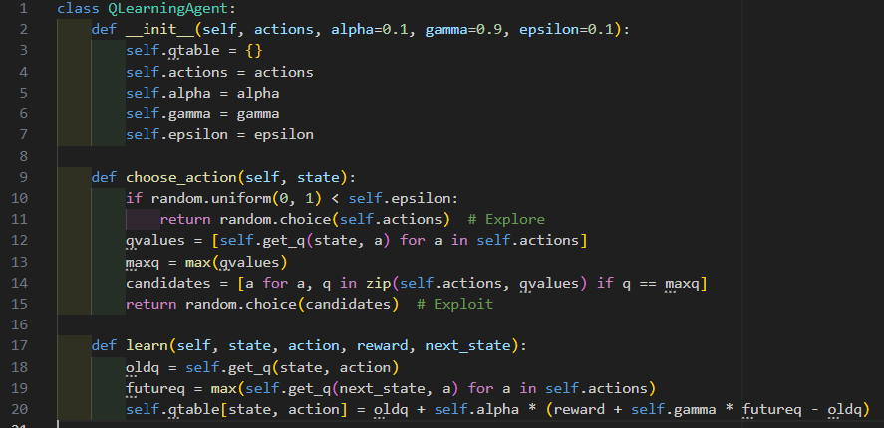
CODE WALKTHROUGH
Initializes learning parameters and Q-table
Picks actions using exploration/exploitation
Learns from reward to improve future choices

Slide 12
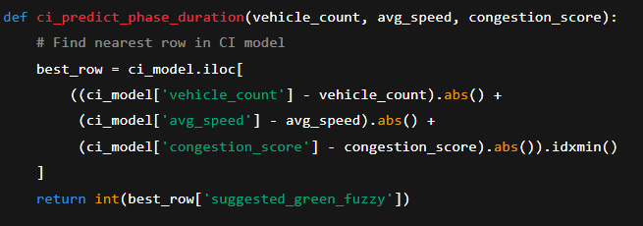
Ingestion: The process begins with the trained CI Model received as a CSV file directly from the CI department.
Processing: Reads the trained CI model from ci_output.csv.
Uses live SUMO lane metrics
(queue, vehicle count, density, occupancy, avg speed).
Predicts a green light duration (suggested_green_fuzzy from the CI model). Applies that to your traffic light MY_TLS.

Slide 13
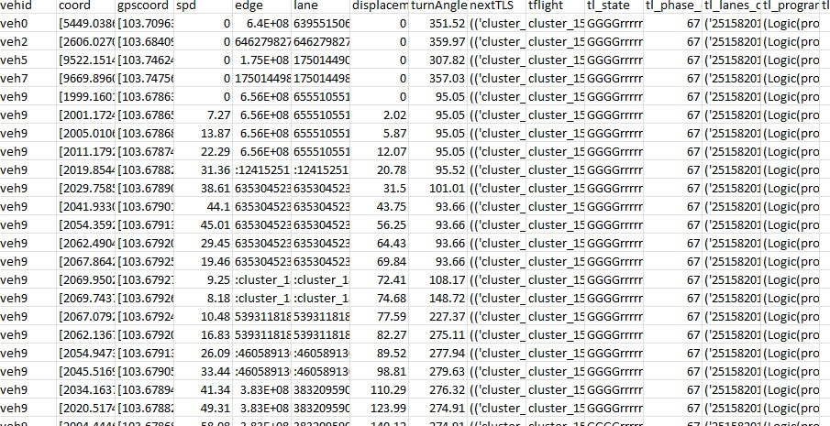
Output: The result of this analysis is a new CSV file. This file contains the processed data and serves as a local edge node for the next stage of the operation.

Slide 14
Edge Node Preprocessing
The processed CSV file acts as an edge node.
It preprocesses the raw data locally for efficiency.
Green light duration values are extracted from every five rows.
Cloud Backup & Decision-Making
Extracted values are sent to the backup cloud.
The cloud performs the final stage of decision-making.
This hybrid setup ensures accuracy, low latency, and high reliability.

Slide 15
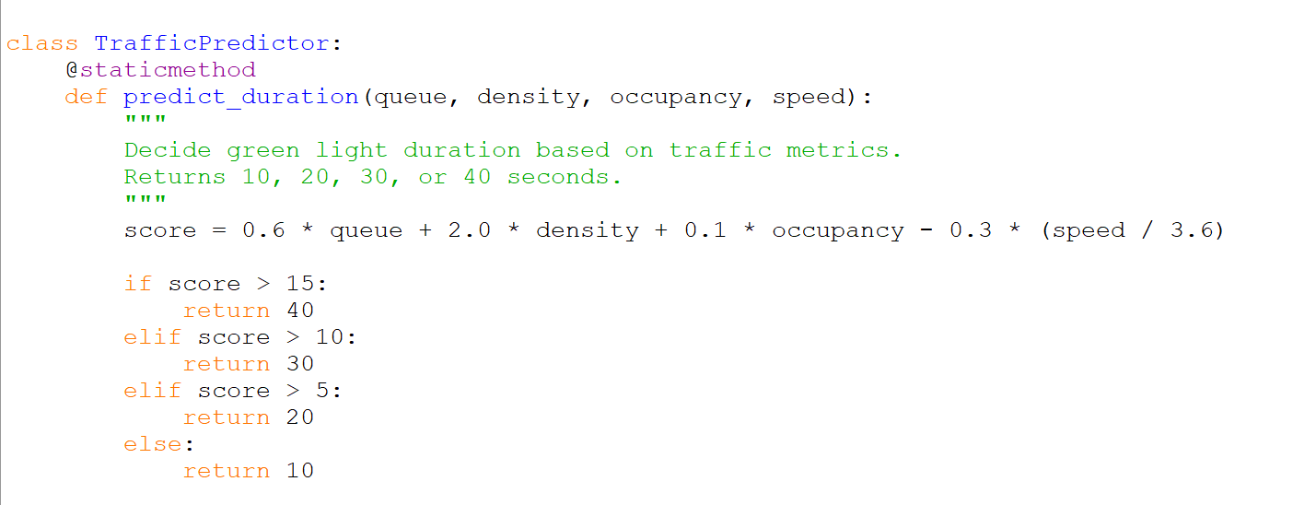
Traffic Signal Prediction at the Edge

